Slide 1

SHOP FOR HOME Capstone Project C3-G2 (GCP)
Presented By:
Gudisetty Sushmitha
Balam Navya Devika
Koli Mounisha
Under the supervision – Parth Shukla

Slide 2

Problem Statement
ShopForHome is a popular Store in the market for shopping the home decor stuff. Due to Covid 19 all the offline shopping stopped . So the store wants to move to the cloud platforms and wants their own web application.

Slide 3
Properties of website
Register Page
order
Login page
Edit profile
Home
Shop For
Home
Admin login
Single product page
Adminproduct
My wishlist
Admin Discount
My cart
Database
Admin User

Slide 4
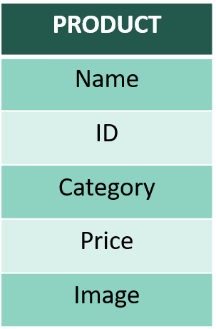
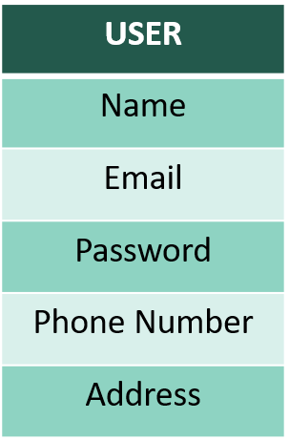
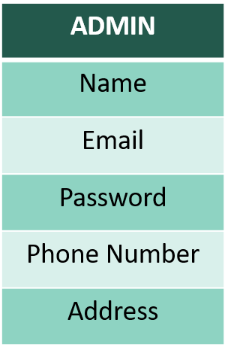
Adds product to the cart
DataBase Scheme
Adds product to display

Slide 5
Angular Type Script Windows7/8/10/11 Java script Boot Java Linux Distros PostgreSql SQL MacOs X or Later HTML CSS
Software Requirements
Technologies
Languages
Operating Systems

Slide 6
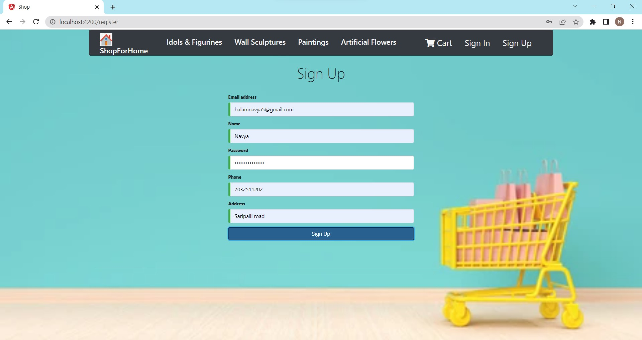
Register Page

Slide 7
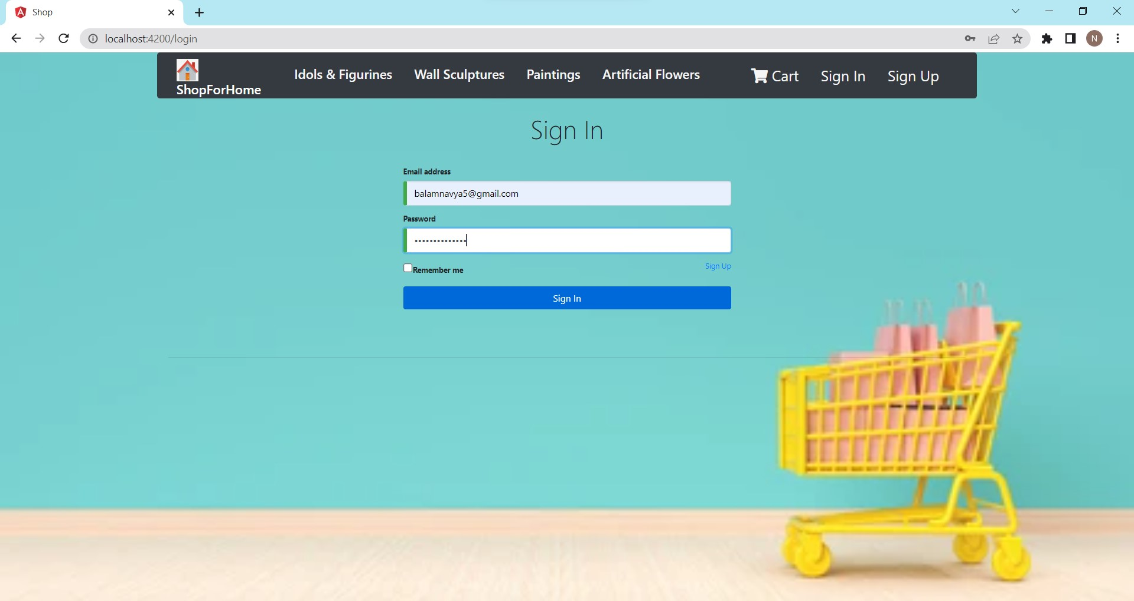
Login page

Slide 8
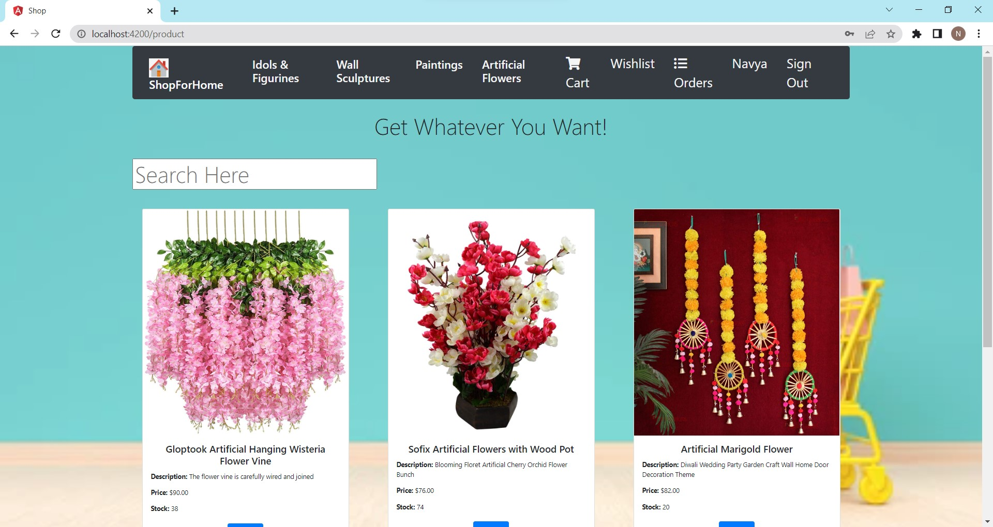
Home page

Slide 9
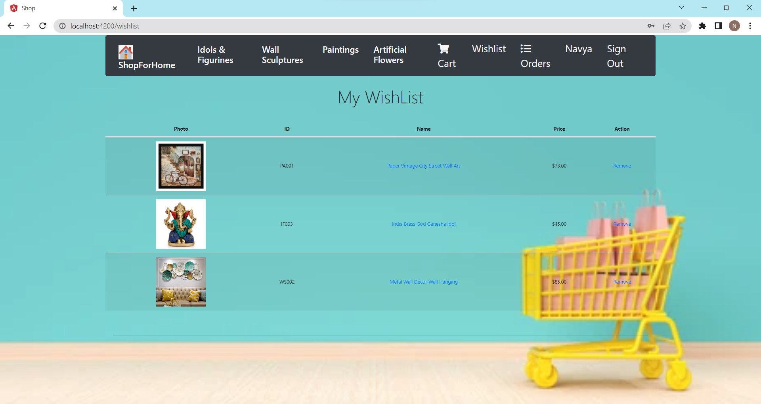
My Wishlist

Slide 10
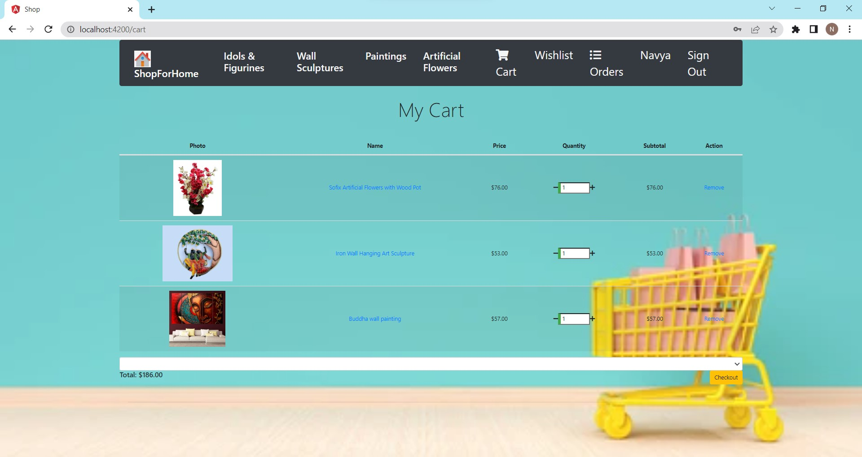
My cart

Slide 11
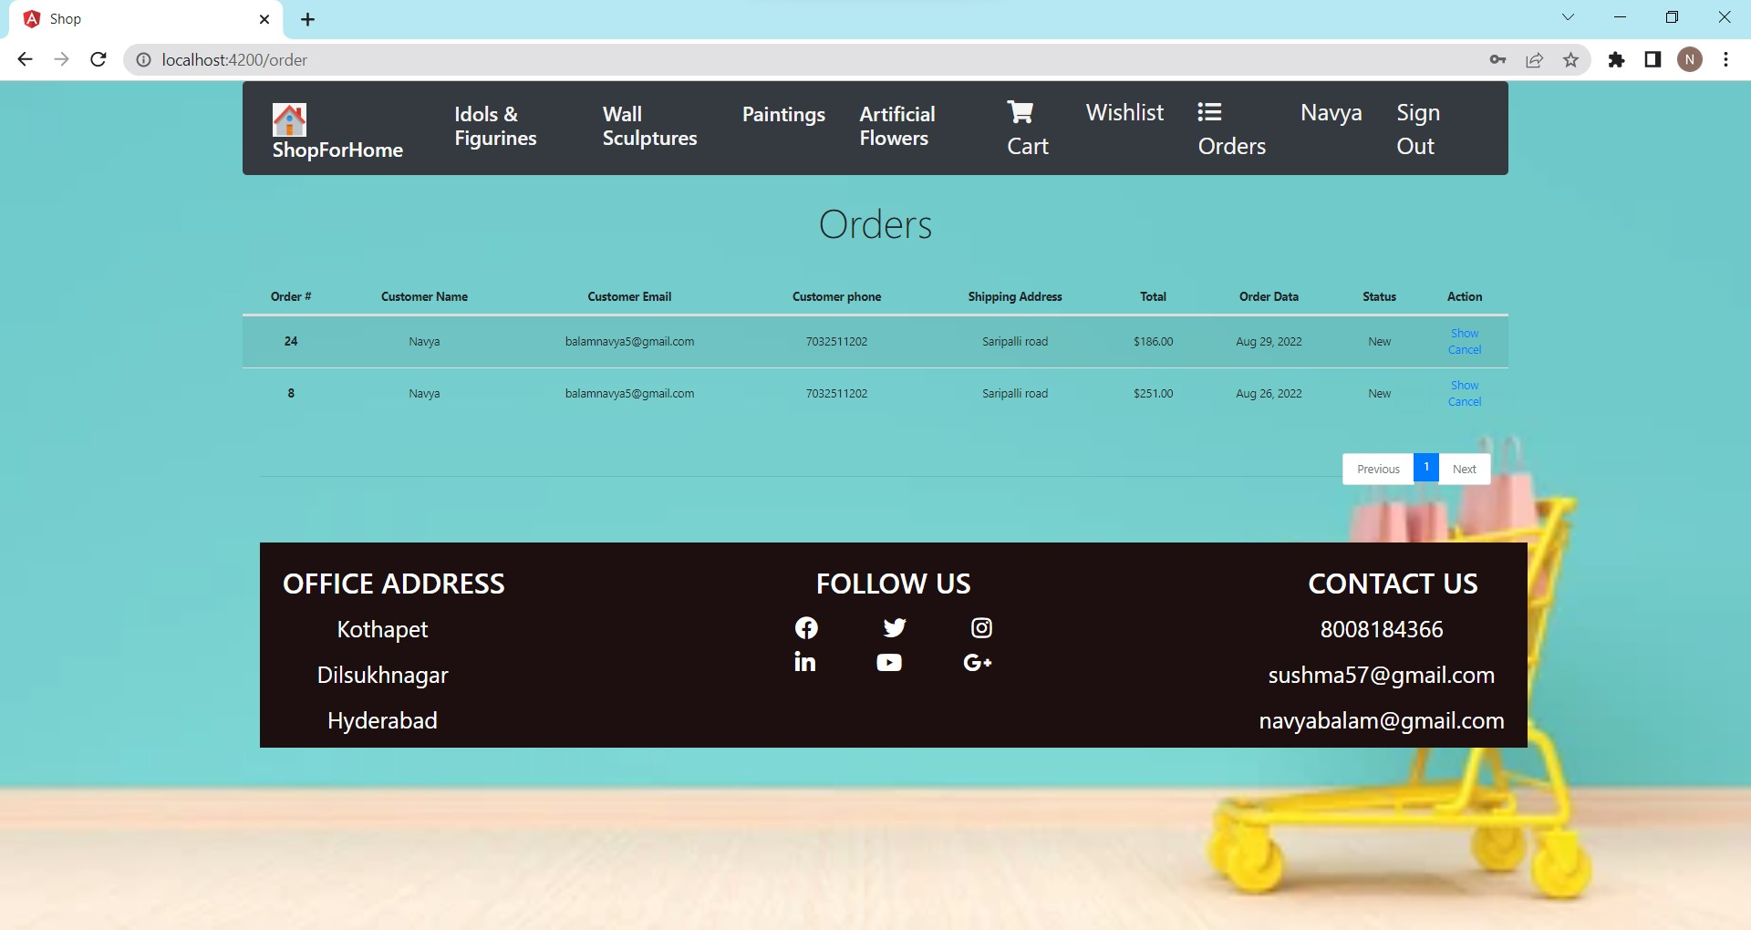
My Orders

Slide 12
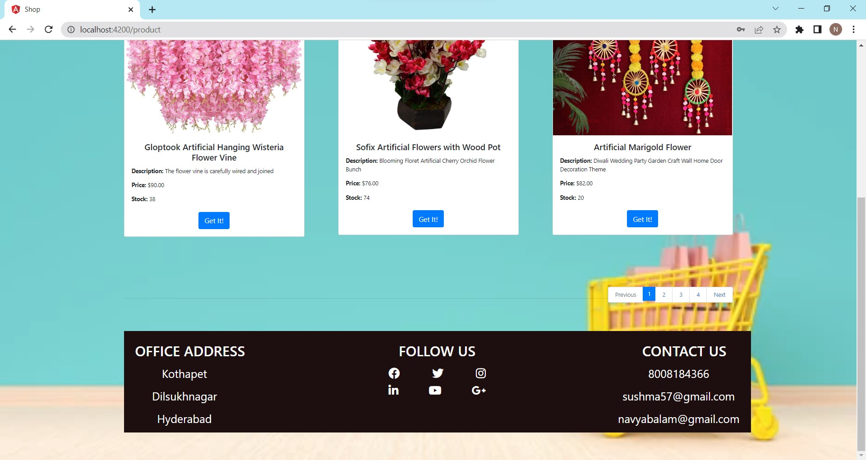
Footer Page

Slide 13
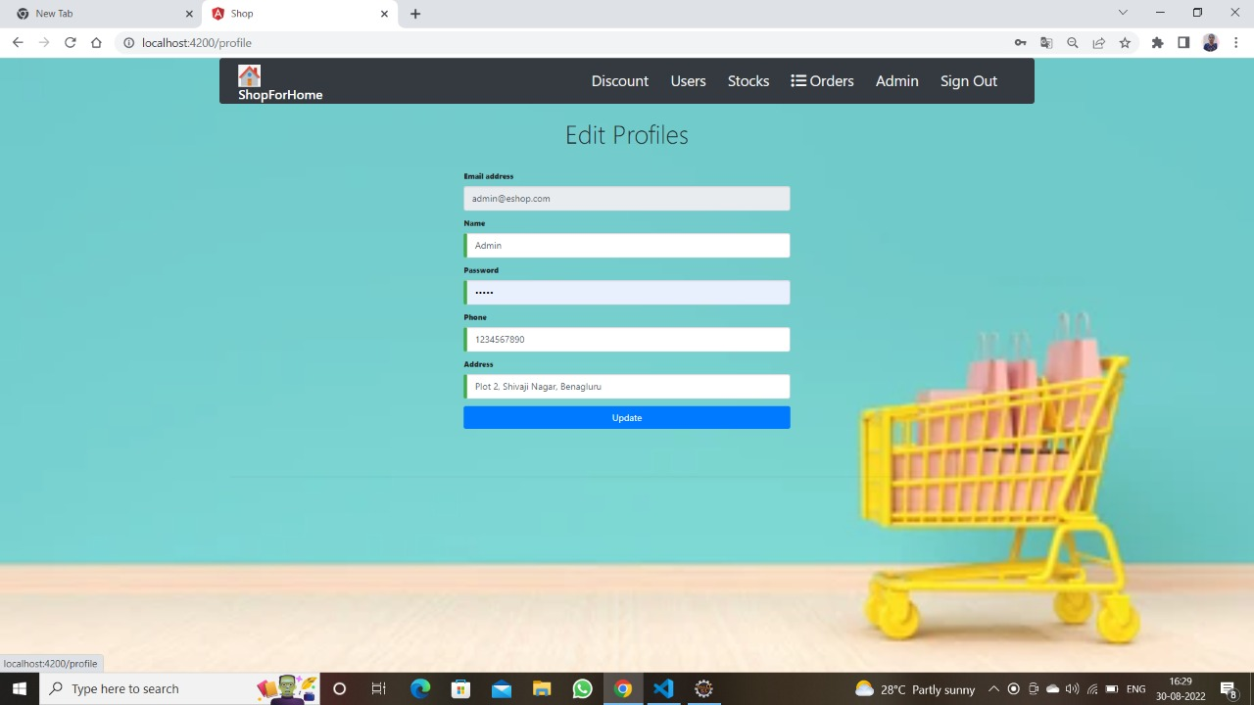
Edit Profiles

Slide 14
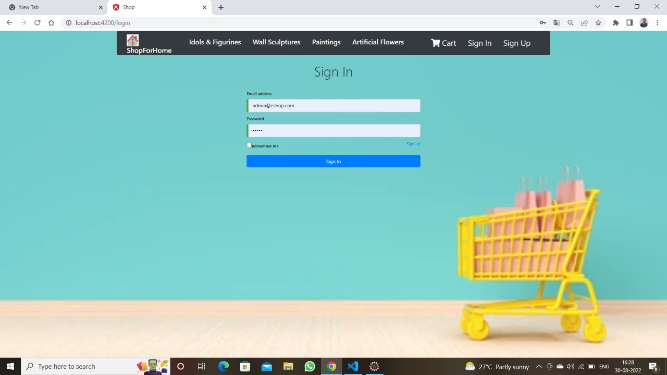
Admin Login

Slide 15
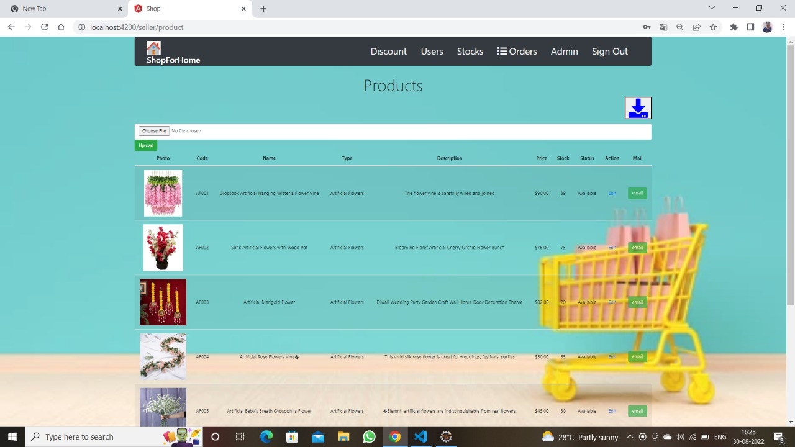
Admin Products and Bulk Upload

Slide 16
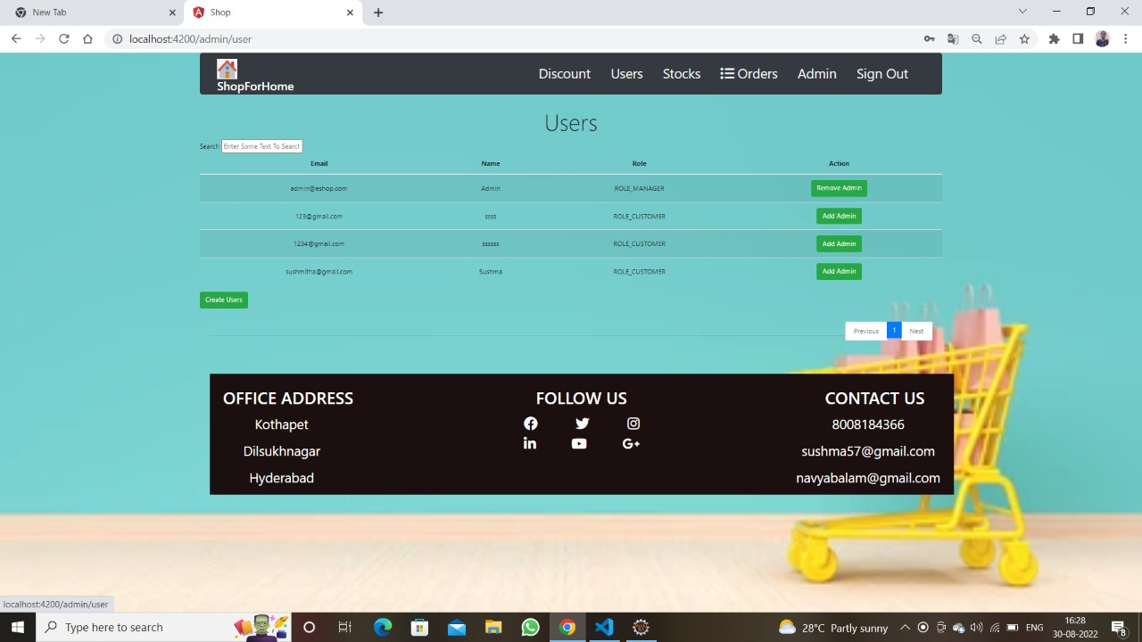
Admin User

Slide 17
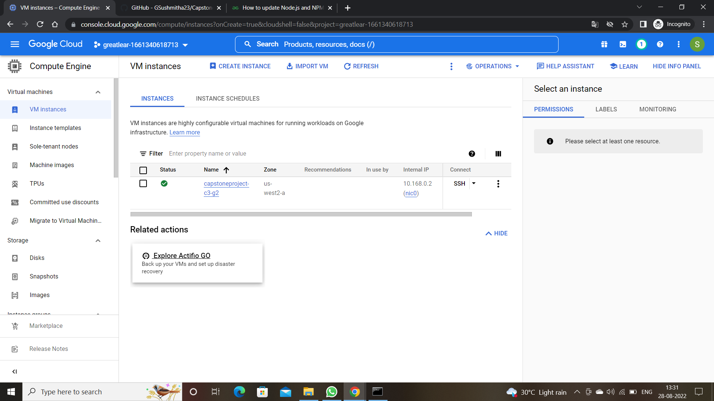
Cloud Deployment- Create VM Instance

Slide 18
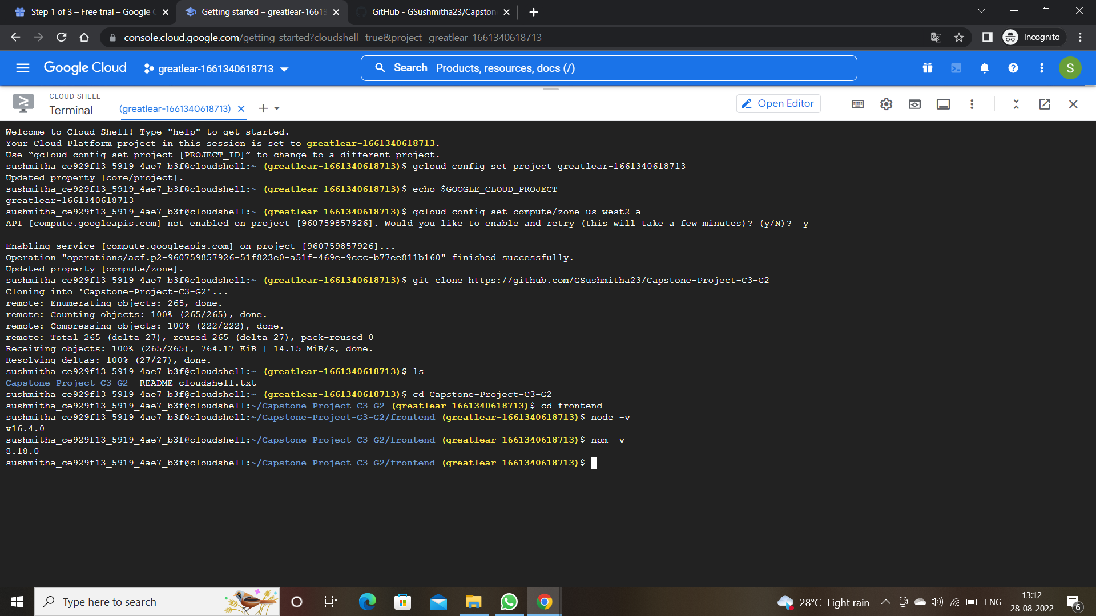

Slide 19
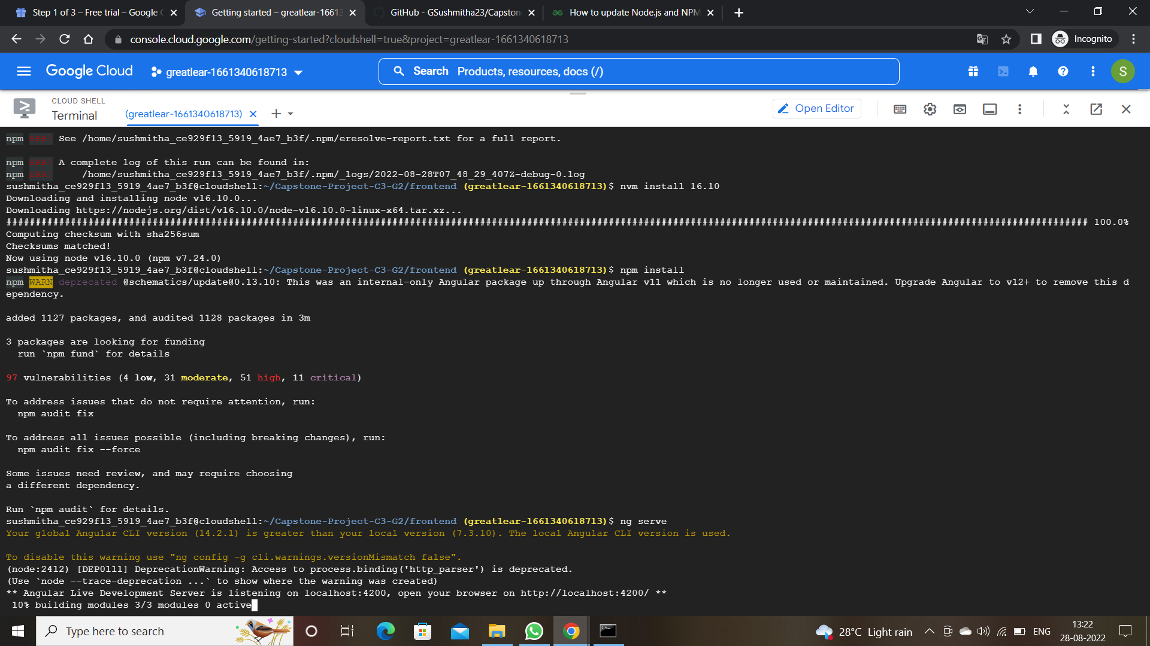

Slide 20
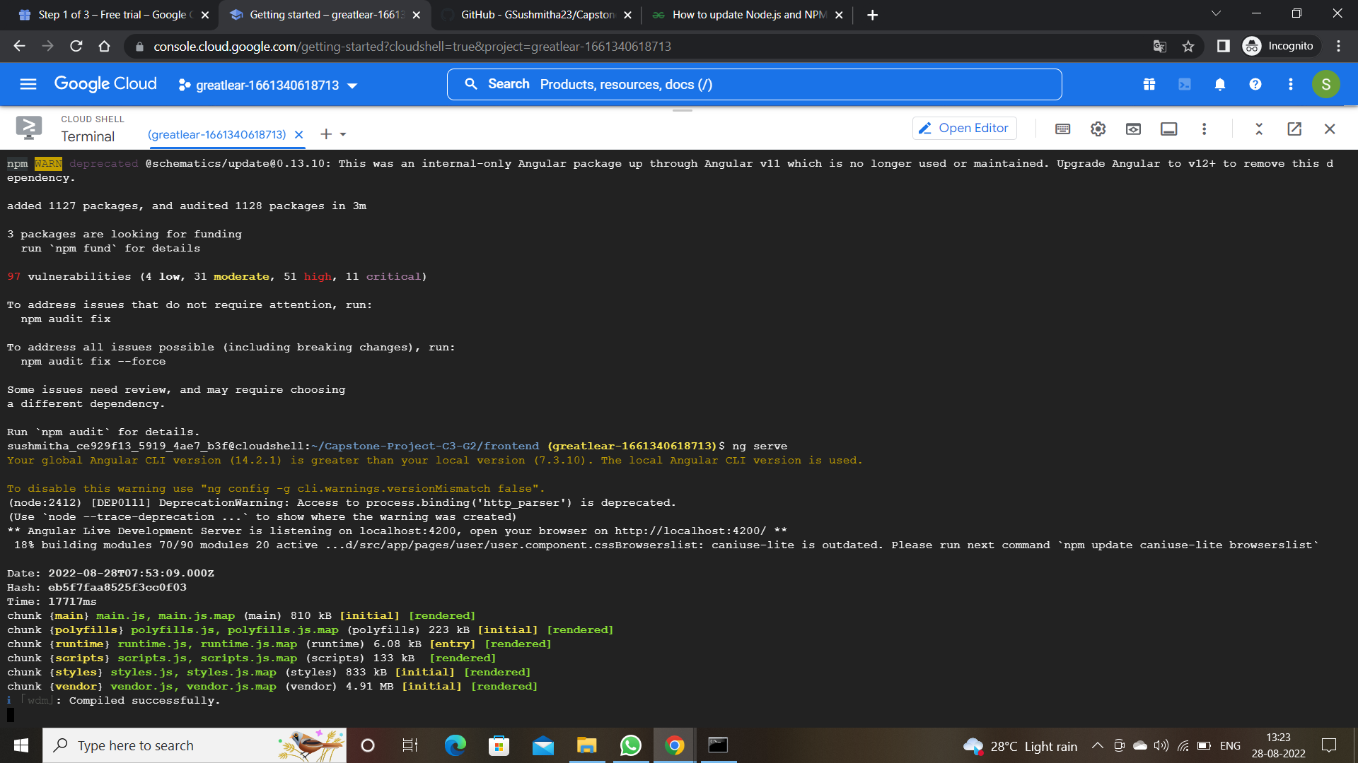

Slide 21
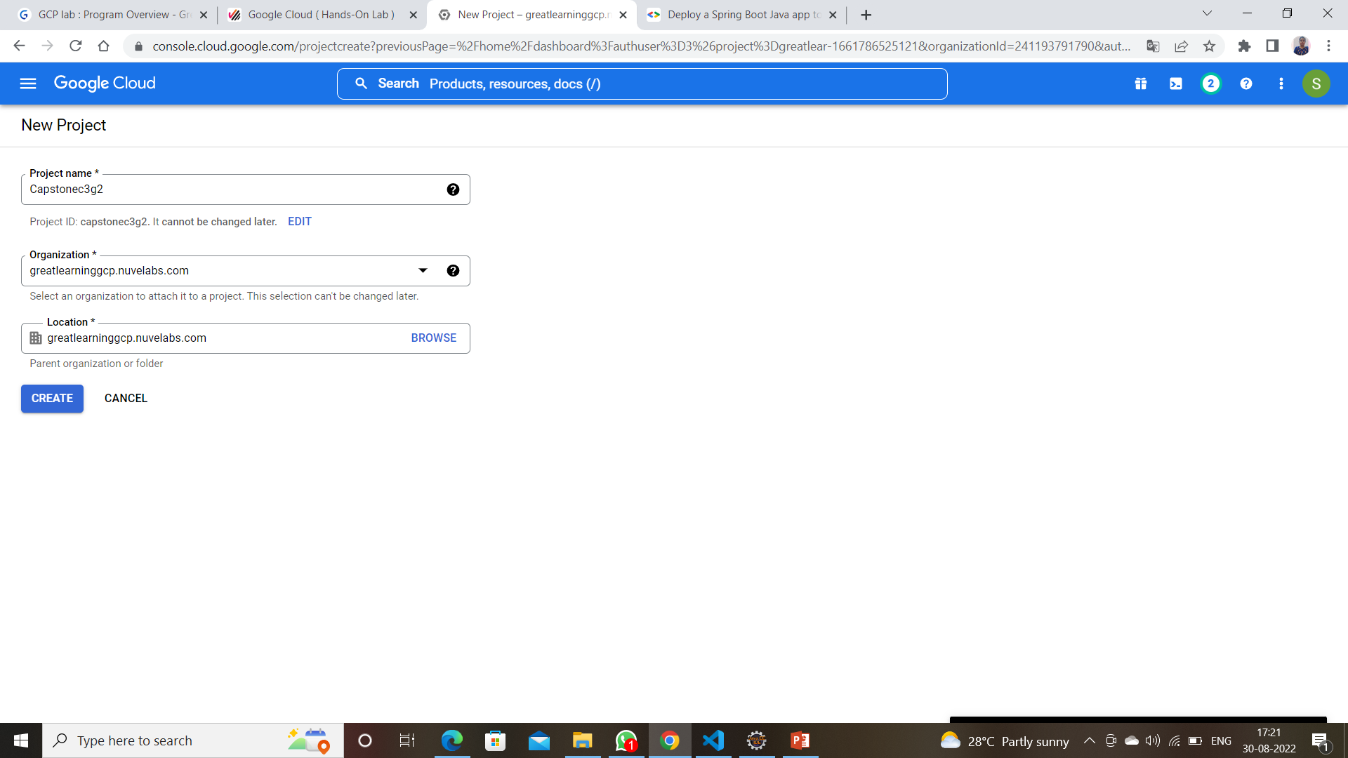
Created Project

Slide 22
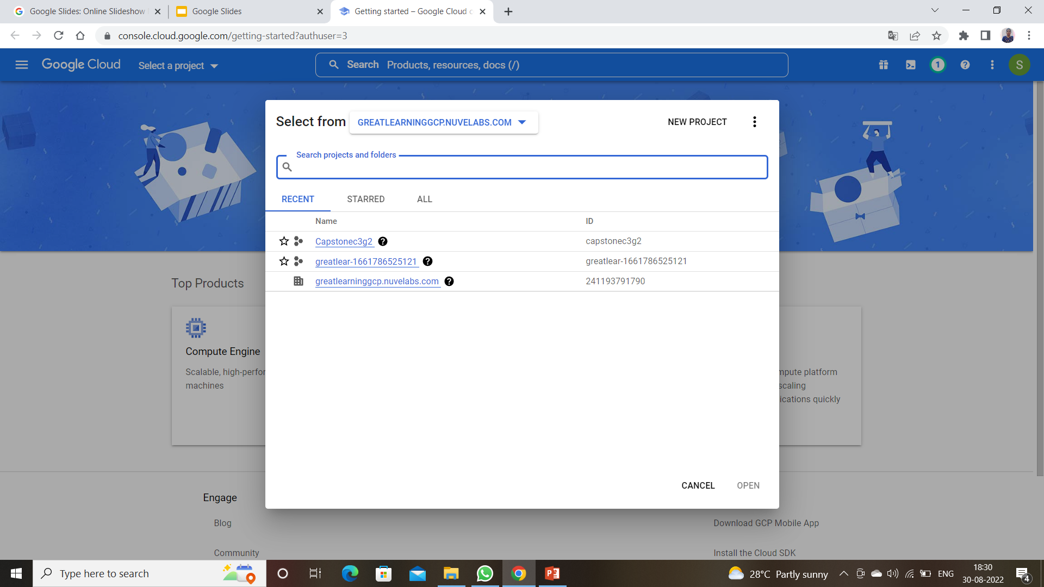

Slide 23
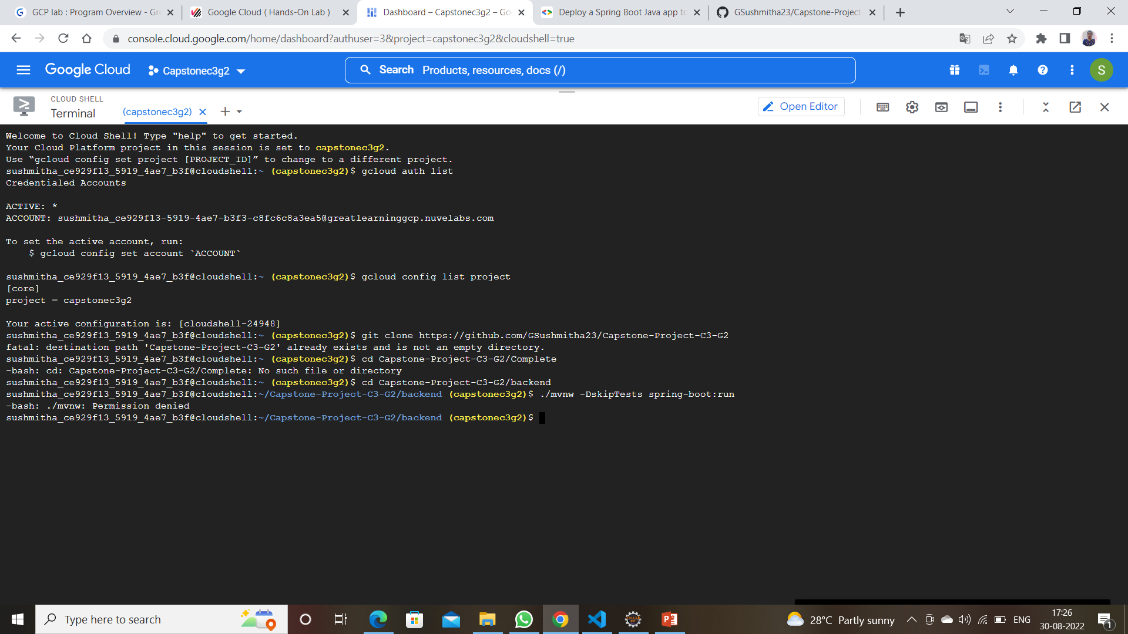

Slide 24
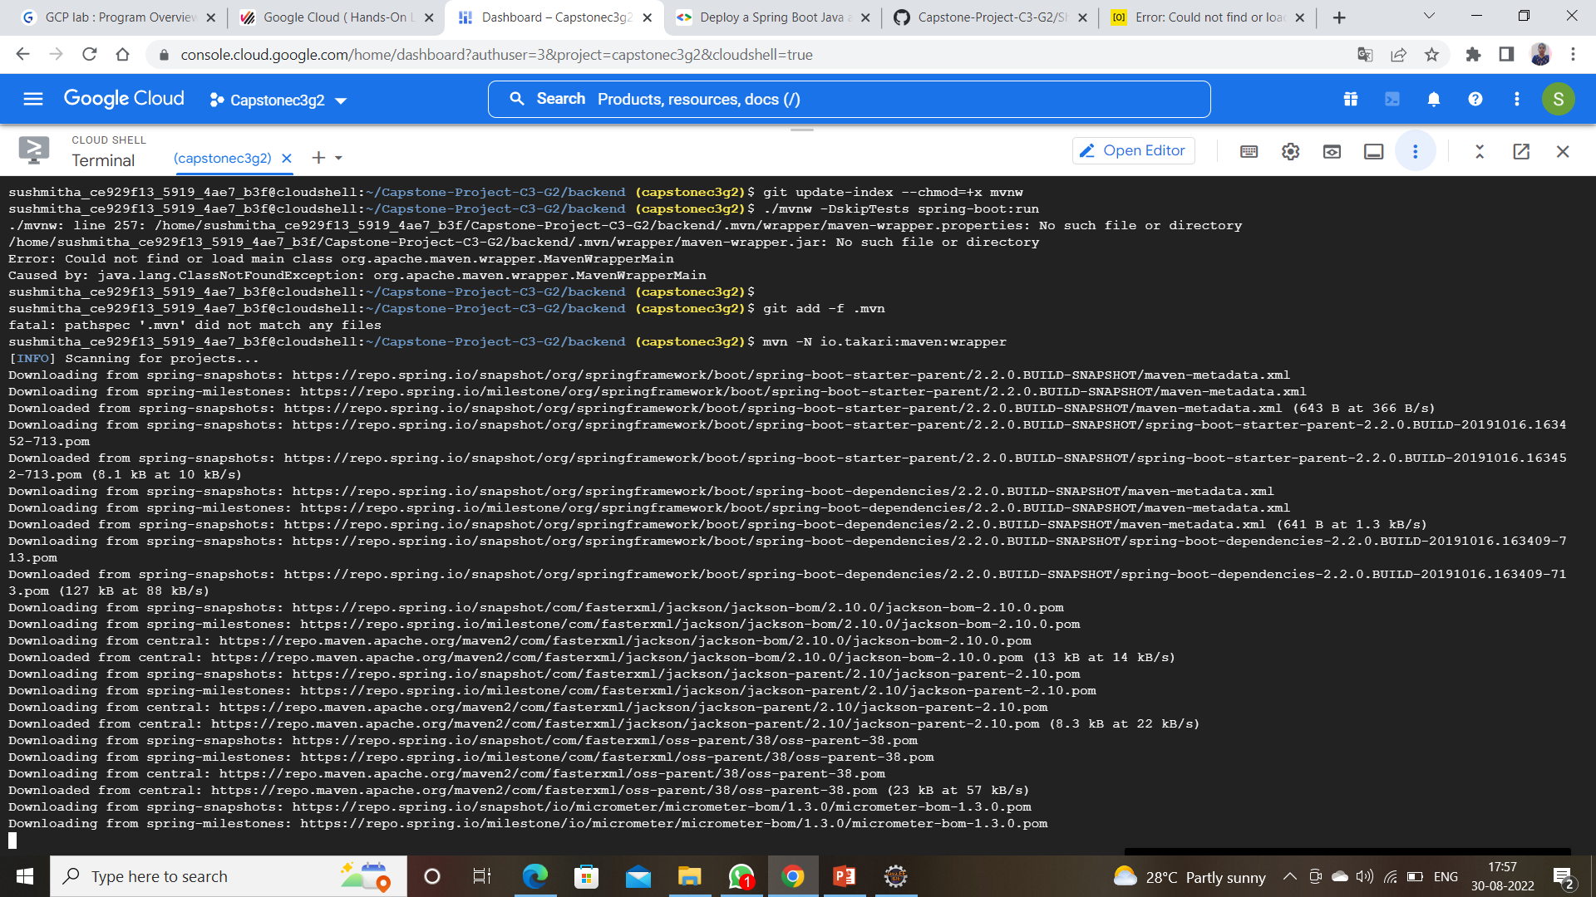

Slide 25
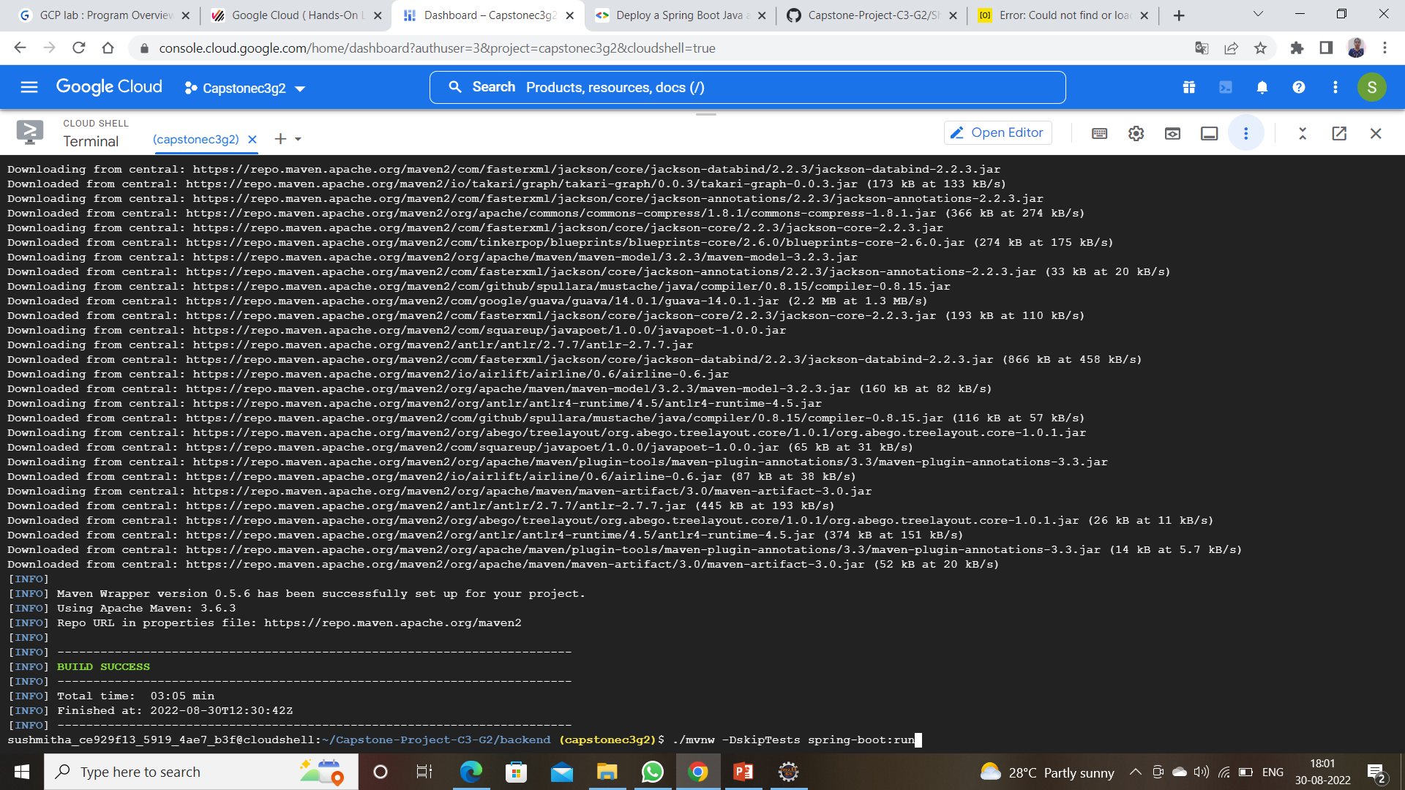

Slide 26
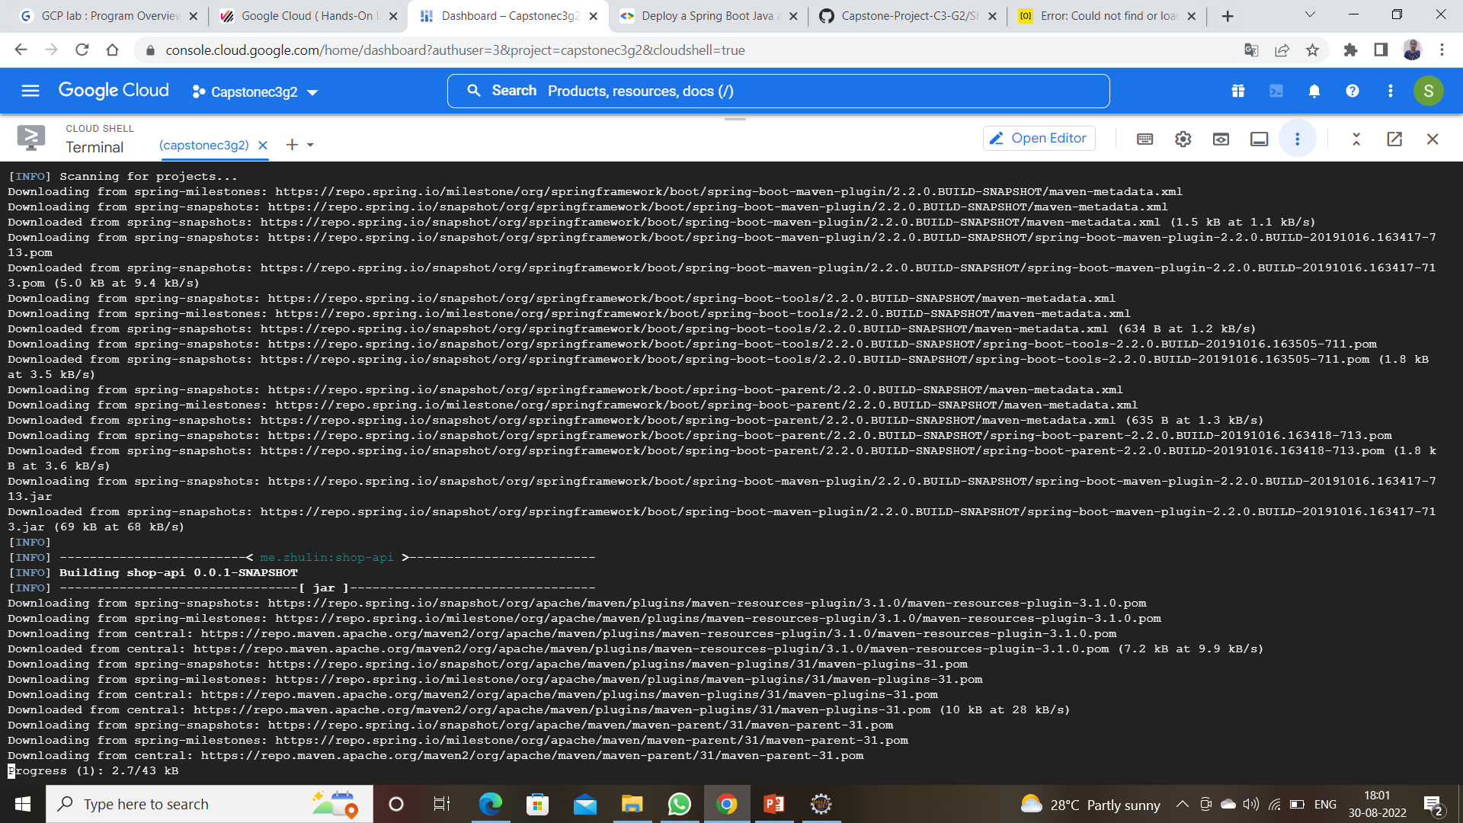

Slide 27
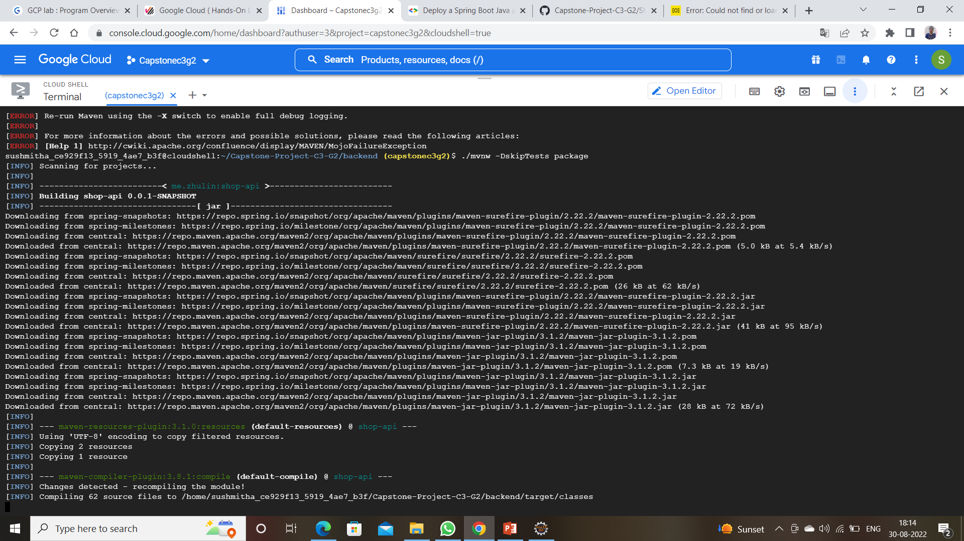

Slide 28
Shop For Home is a user-friendly web Application made for Home Store. User Can Search For a Product, Add the product into the cart, and Add the product to the wishlist easily.
Despite of covid of Covid19 this web application can be used to run a business online successfully.

Slide 29


